Slide 1
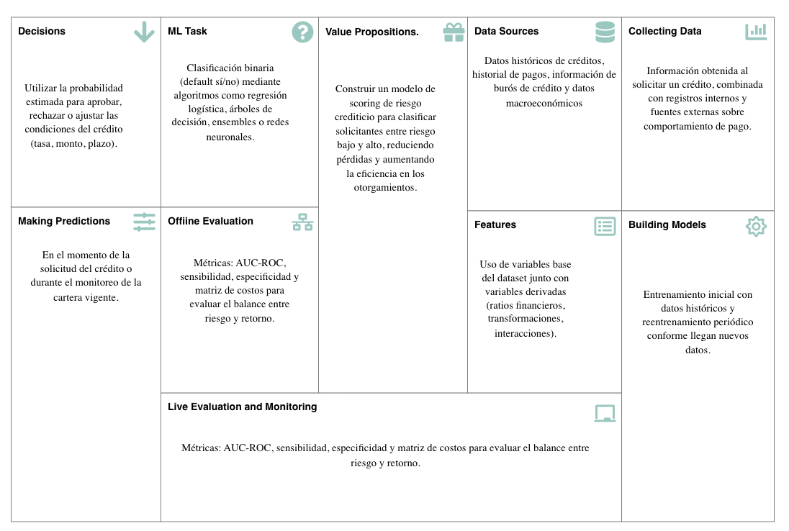
ML Canvas South German Credit

